Slide 1




Computation Flowchart – Controller
Reference Trajectory

Slide 2


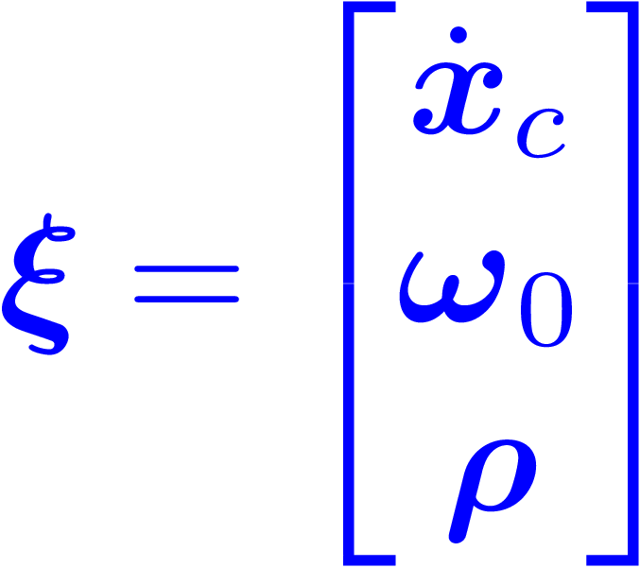


Computation Flowchart – Controller
Control – Transformed State

Slide 3





Computation Flowchart – Controller
Control – Disturbance Observer (GMO)
Note that will be updated after u is computed.

Slide 4










Computation Flowchart – Controller
Control – Translation
Notes:
Since \dot{d}_t \approx. 0, the corresponding terms are omitted in \dot{f}_d and \ddot{f}_d.

Slide 5
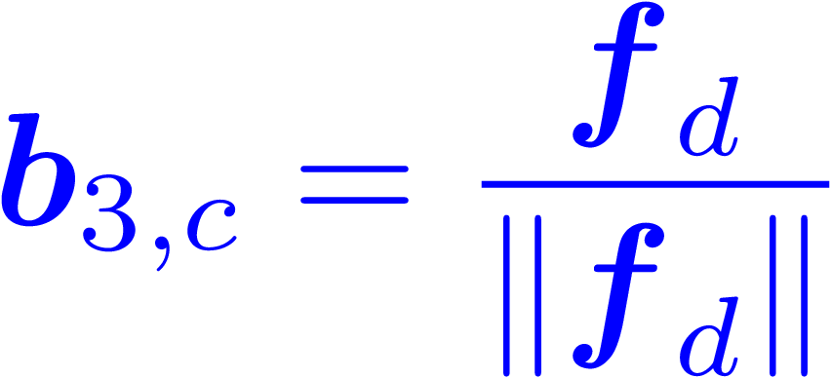




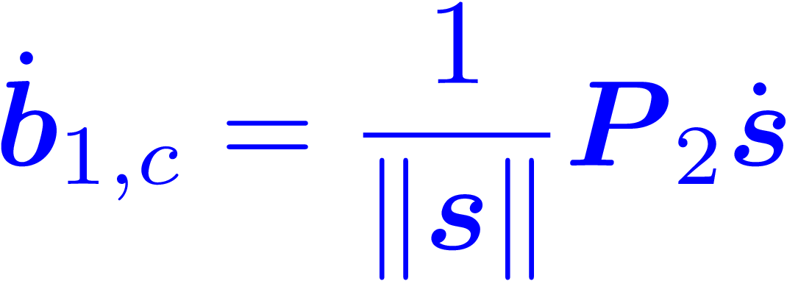
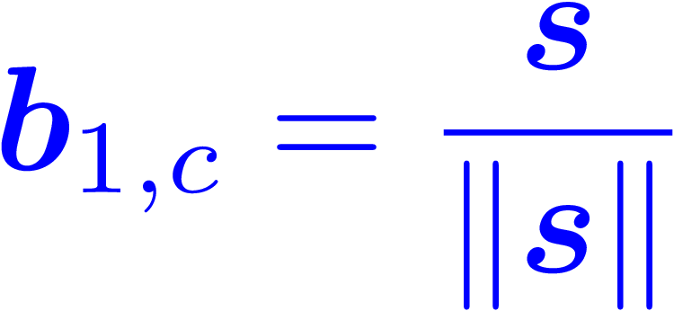







Computation Flowchart – Controller
Control – Rotation

Slide 6




Computation Flowchart – Controller

Slide 7



Computation Flowchart – Controller

Slide 8












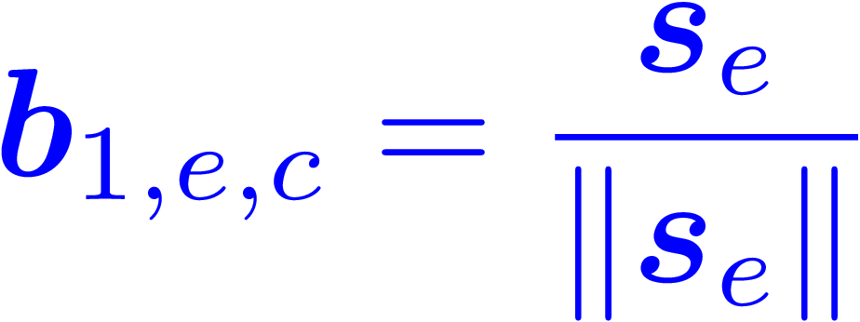




Computation Flowchart – Controller
Control – Arm

Slide 9



Computation Flowchart – Controller

Slide 10

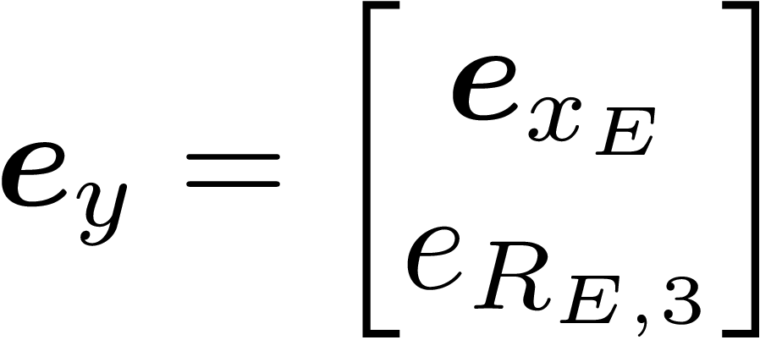


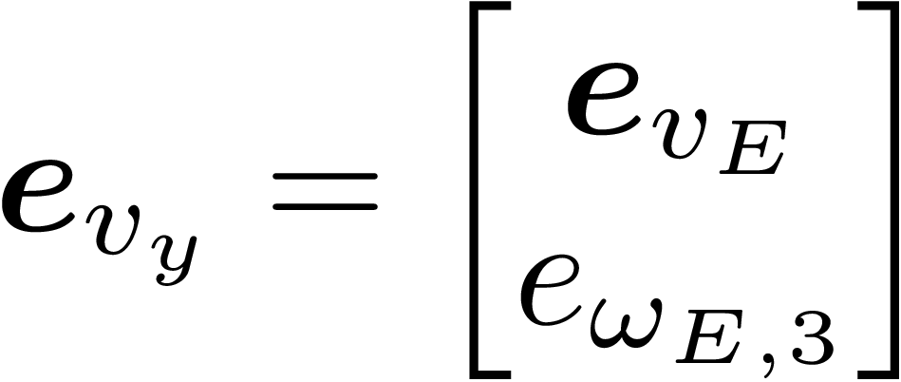
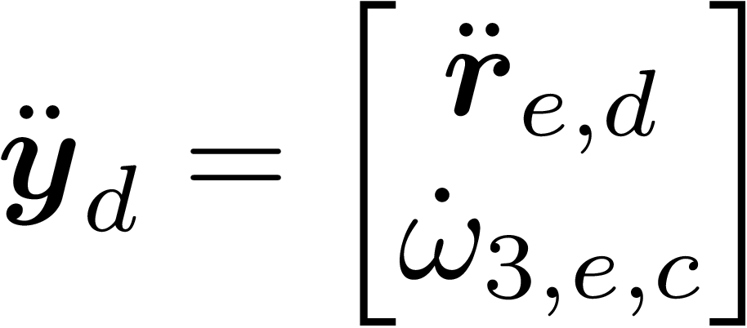
Computation Flowchart – Controller

Slide 11


Computation Flowchart – Controller
The translational block of My is isotropic.

Slide 12
Computation Flowchart – Controller

